Slide 1
WELCOME
Weekly Report
Vatsla Adhikari
Dec. 15, 2023

Slide 2
INDEX
Slide 1: Weekly Report
Slide 2: Index
Slide 3: Object Detection using YOLOv8 and Roboflow
Slide 4: Code API Table and Summary
Slide 5-: Roboflow Output
Slide 6-11: Code Output

Slide 3
Objective: Object Detection using YOLOv8 and Roboflow
YOLOv8 (You Only Look Once version 8):
  YOLO is an object detection algorithm that stands for "You Only Look Once." It's designed to detect and classify multiple objects in an image with a single forward pass of the neural network.
  YOLOv8 is the eighth version of the YOLO series, and it comes with improvements over its predecessors. It is known for its speed and accuracy in real-time object detection tasks.
  For the code; particle detection in the images captured by the sensor, YOLOv8 is used for training, validation, and prediction tasks. The code involves specifying YOLOv8 model parameters, training the model on a custom dataset, and then using the trained model for detection tasks.
Roboflow:
  Roboflow is a platform for managing, annotating, and augmenting image datasets for machine learning. It provides tools to streamline the process of preparing image data for training machine learning models.
  For the code; particle detection in the images captured by the sensor,, Roboflow is used to download a dataset for training the YOLOv8 model. The Roboflow Python library is imported and used to interact with the Roboflow API to access the specified project and dataset. This simplifies the process of dataset management and retrieval.

Slide 4
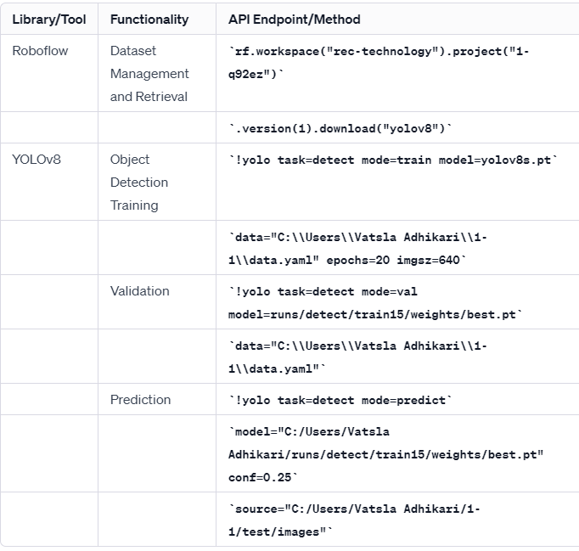
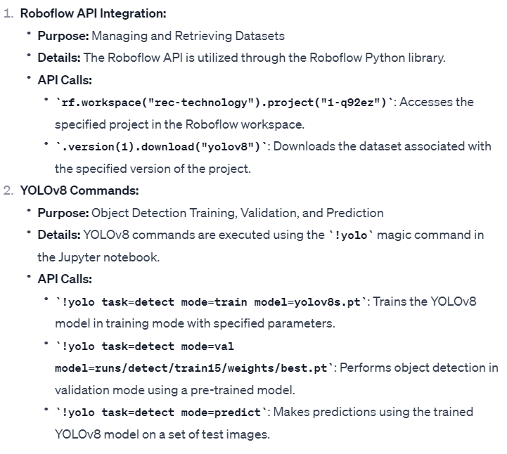
Objective: Code API Table and Summary
API Table
Summary:

Slide 5
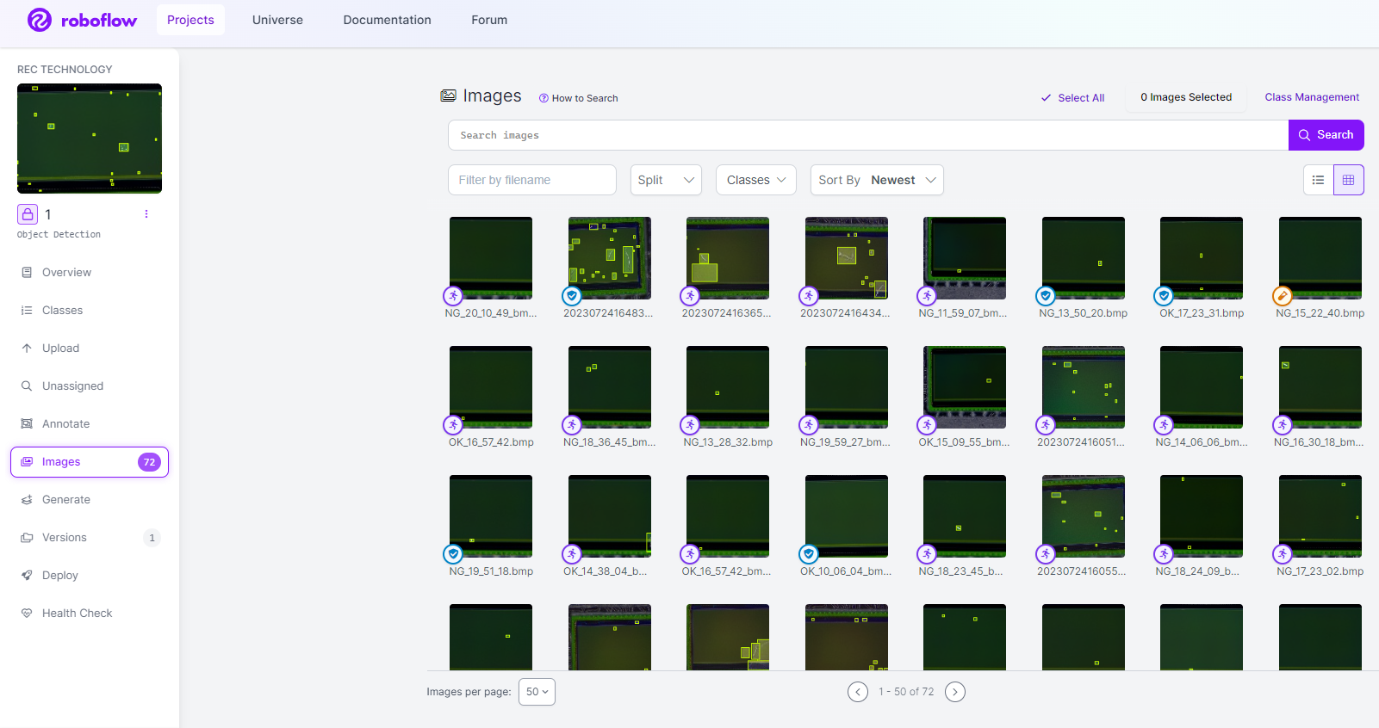
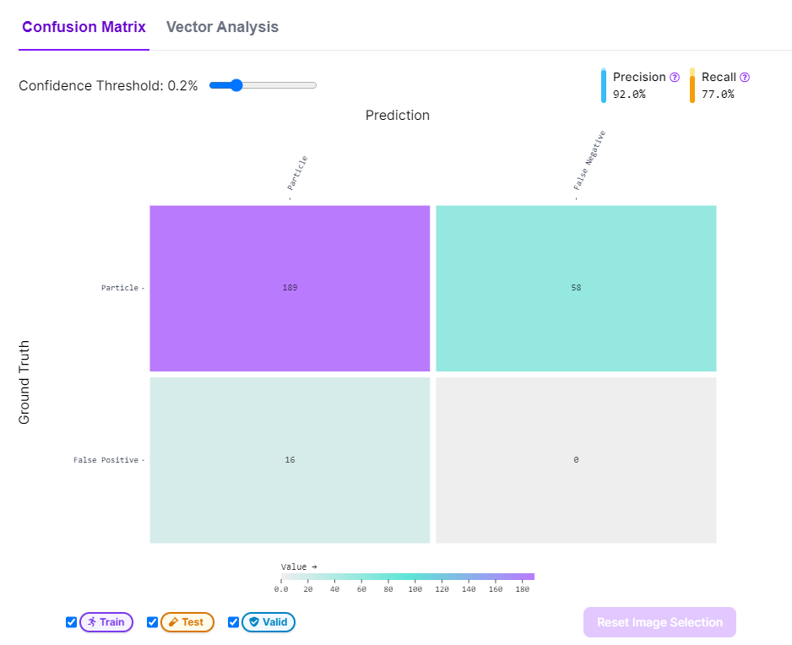
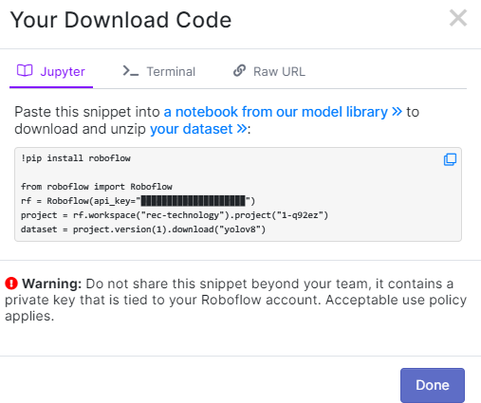
Objective: Roboflow Output
Labelled Dataset: 72 images used
Train: 50 images
Valid: 15 images
Test: 7 images
API Key
and code

Slide 6
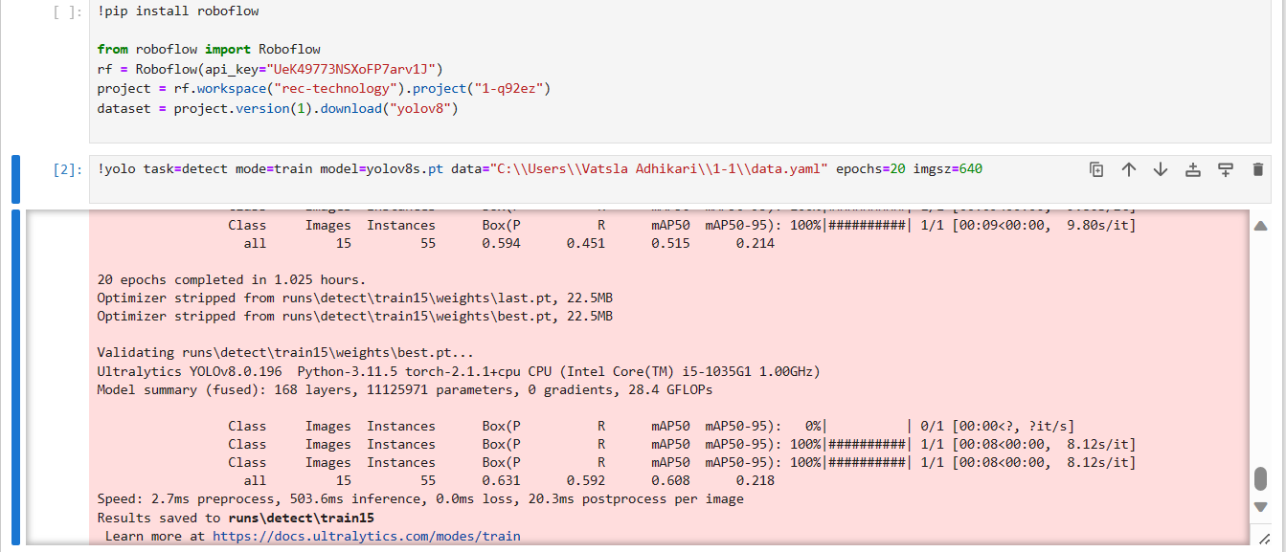
Objective: Code Output
Training the data

Slide 7
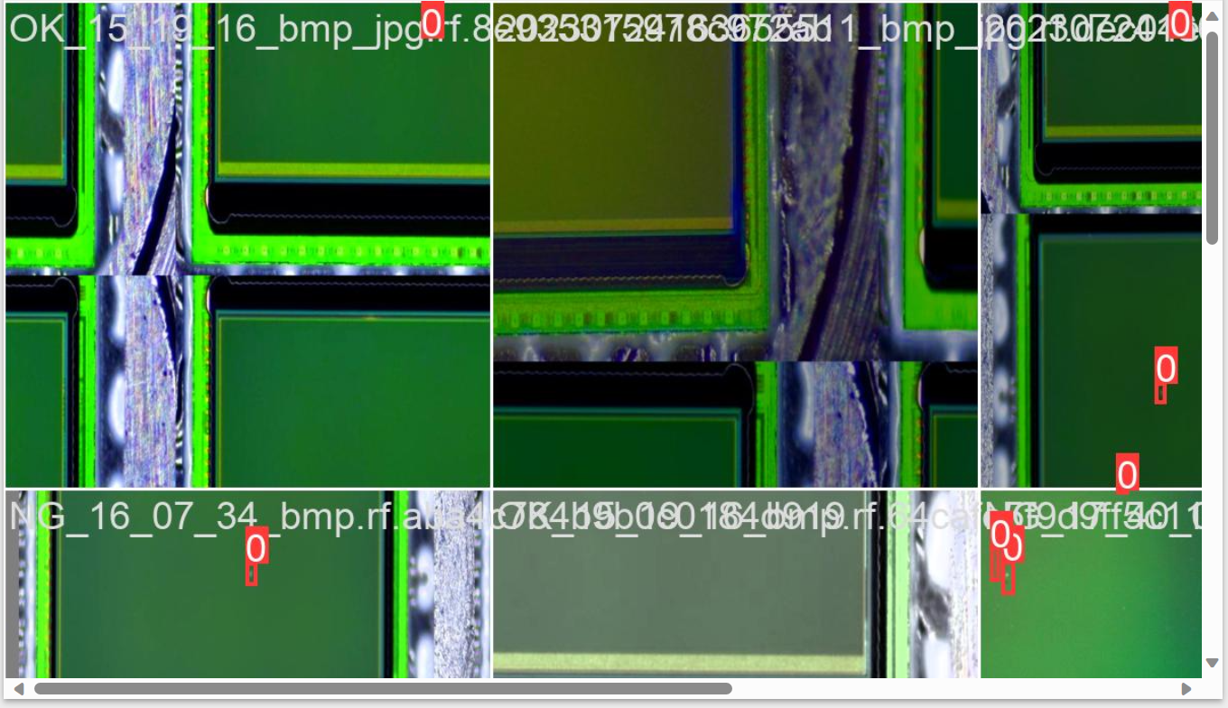
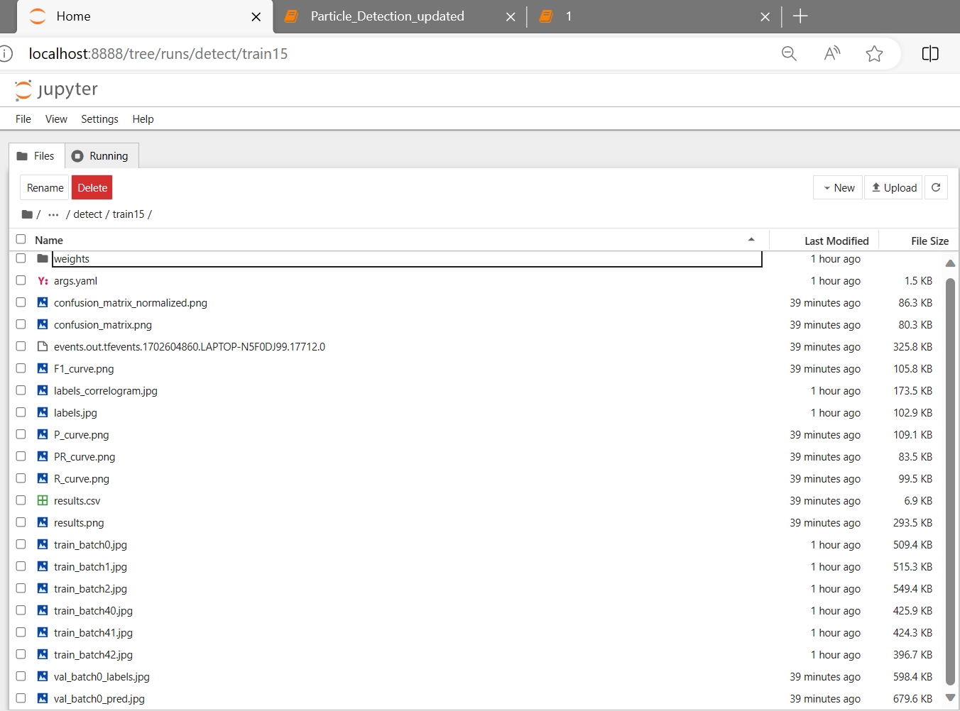
train_batch0
Output: train15

Slide 8
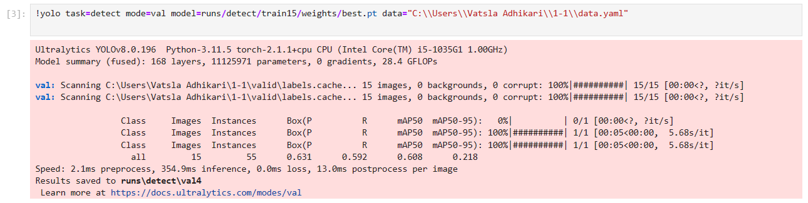
Objective: Code Output
Validating the data

Slide 9
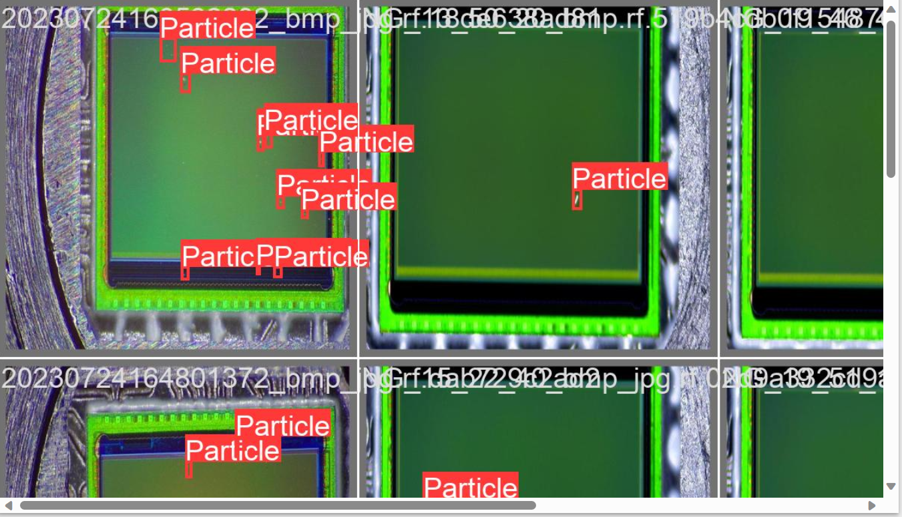
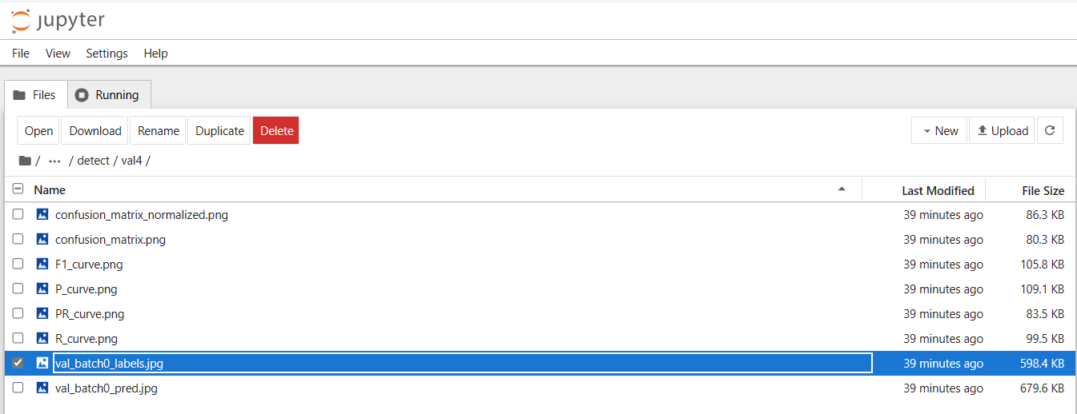
val_batch0
Output: val4

Slide 10
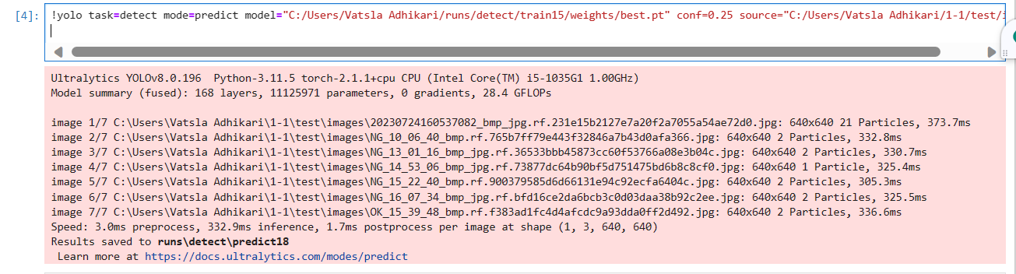
Objective: Code Output
Predicting the data

Slide 11
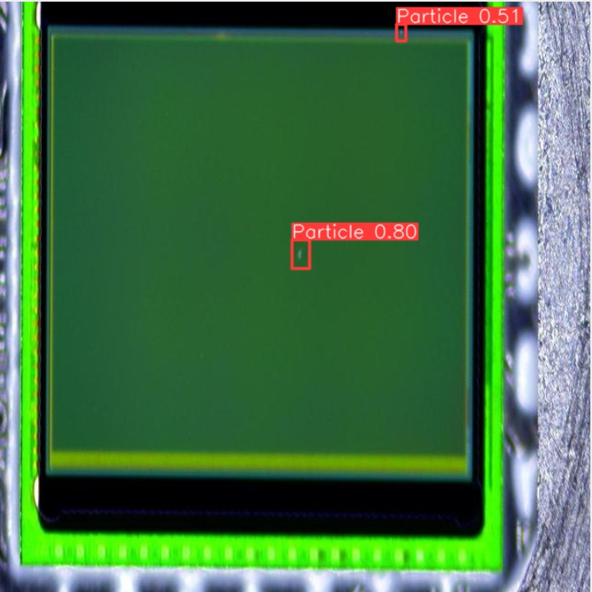
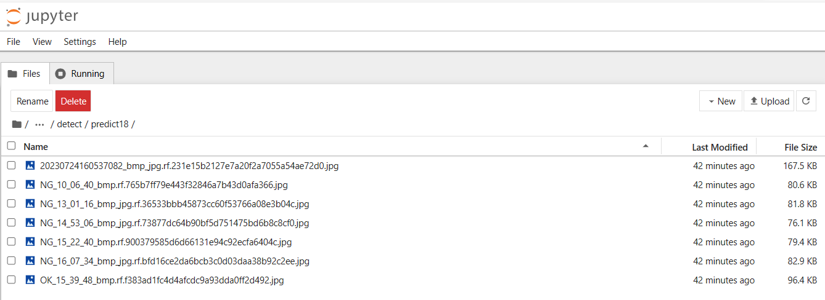
One of the predicted images
Output: predict18

Slide 12
Thank You!
REC Technology
Corporation
瑞柯科技
股份有限公司

